Slide 1

An Automated Annotation System for Document Text Images
GOKARAJU RANGARAJU INSTITUTE OF ENGINEERING AND TECHNOLOGY
Department of Computer Science and Engineering
MAJOR Project Phase-II Review-2
~Dr. Ashlin Deepa R N, Associate Professor
  Jhansi Lakshmi - 20241A0566
    B. Srija - 20241A0564
    Maria Jabeen - 20241A0593
    K. Kushi Reddy - 20241A0583

Slide 2
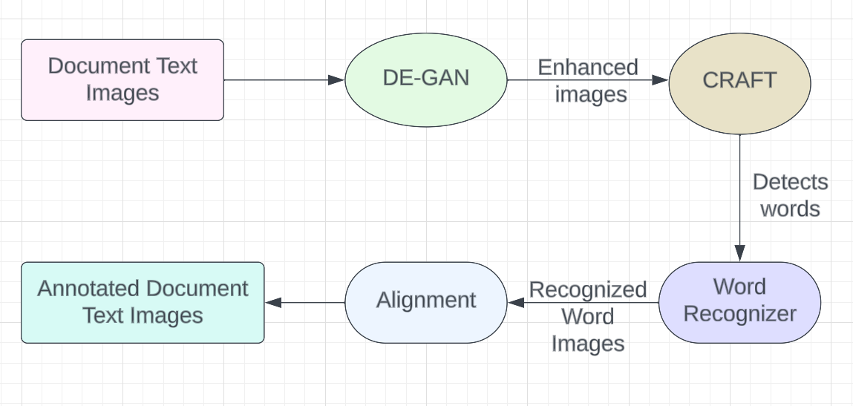
Fig 1: Architecture
GOKARAJU RANGARAJU INSTITUTE OF ENGINEERING AND TECHNOLOGY
Department of Computer Science and Engineering
MAJOR Project Phase-II Review-2
Proposed Architecture:

Slide 3
GOKARAJU RANGARAJU INSTITUTE OF ENGINEERING AND TECHNOLOGY
Department of Computer Science and Engineering
MAJOR Project Phase-II Review-2
Modules:
There are four main modules in our project.
De-GAN Module:
De-GAN utilizes Generative Adversarial Networks (GANs) for denoising handwritten documents.
It identifies and removes various types of noise, such as background artifacts and smudges.
It enhances the overall quality of scanned documents, making them more legible and suitable for annotation.
CRAFT Module:
After binarizing the image using De-GAN, it is sent to CRAFT model.
CRAFT is a text detection model that uses a Convolutional Neural Network(CNN) model to accurately extract text regions from the document images.
It analyzes pixel-level information to determine character and word boundaries.

Slide 4
GOKARAJU RANGARAJU INSTITUTE OF ENGINEERING AND TECHNOLOGY
Department of Computer Science and Engineering
MAJOR Project Phase-II Review-2
Recognition Module :
The model is a Convolutional Recurrent Neural Network (CRNN) designed for text recognition from images. Here's a simplified overview:
CNN Backbone: Utilizes a pre-trained ResNet model for feature extraction from input images.
CNN Part 2: Additional convolutional layers for further feature refinement.
Linear Layers: Dimensionality reduction and transformation of features.
Recurrent Layers: Bidirectional GRU layers for sequential processing.
Output Layer: Linear layer for generating character predictions.
Annotation Module:
We have implemented annotation by leveraging the recognized text from the recognition process and integrating it with the dimensions acquired from the craft module. This combination allows us to precisely annotate the relevant regions within the image, enhancing its interpretability and facilitating further analysis.

Slide 5
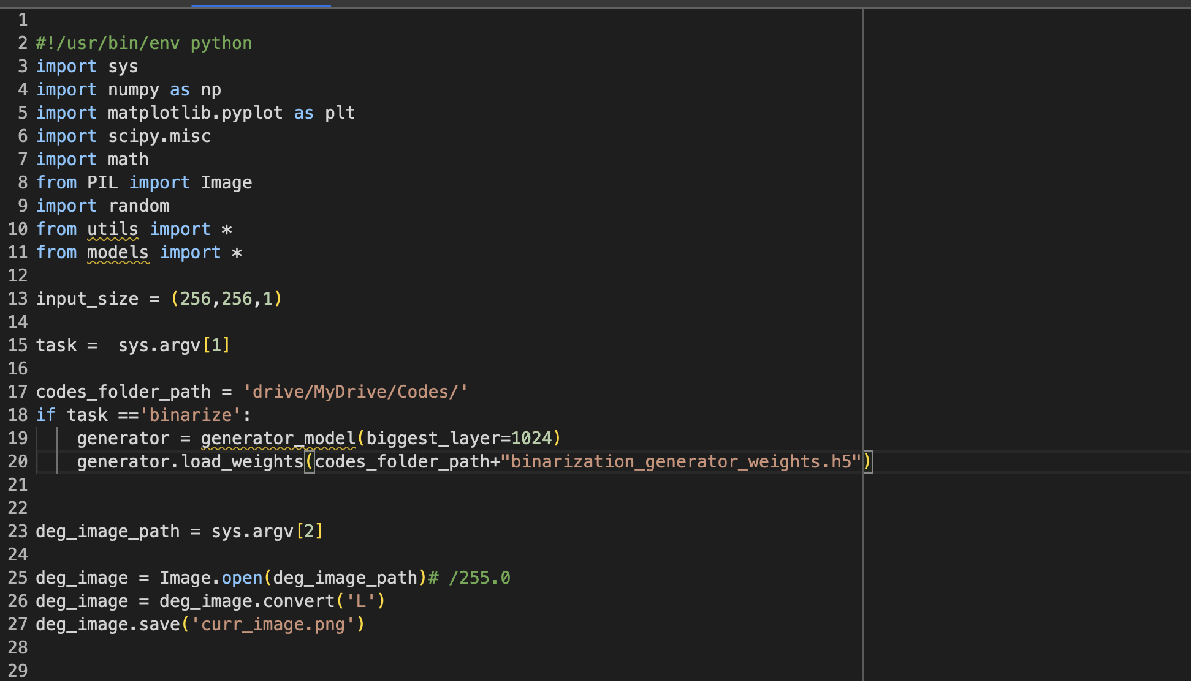
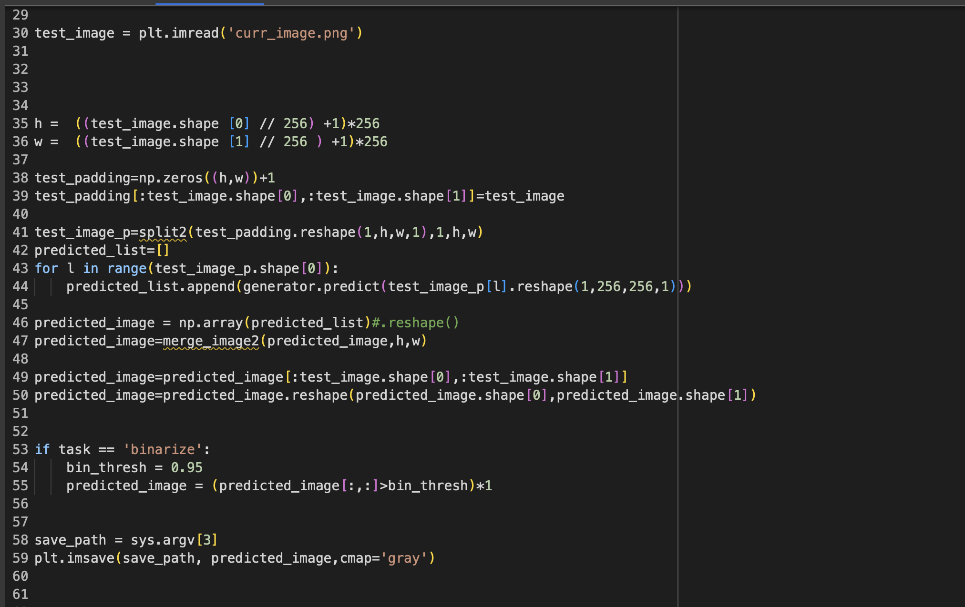
GOKARAJU RANGARAJU INSTITUTE OF ENGINEERING AND TECHNOLOGY
Department of Computer Science and Engineering
MAJOR Project Phase-II Review-2
Experimentation:
Fig 2: De-GAN Module Fig 3: De-GAN

Slide 6
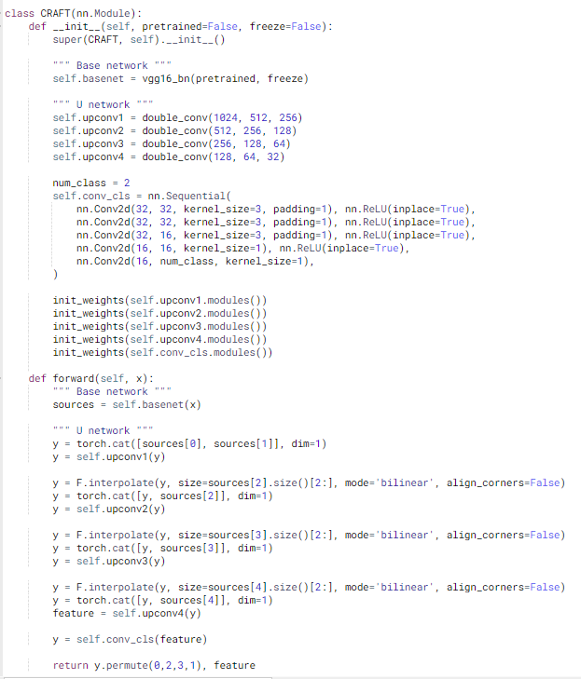
Fig 4: CRAFT Module
GOKARAJU RANGARAJU INSTITUTE OF ENGINEERING AND TECHNOLOGY
Department of Computer Science and Engineering
MAJOR Project Phase-II Review-2
Experimentation

Slide 7
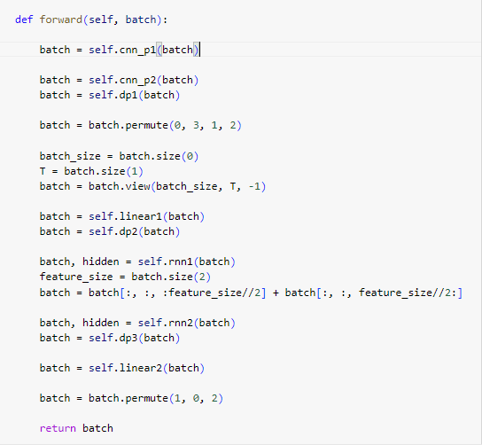
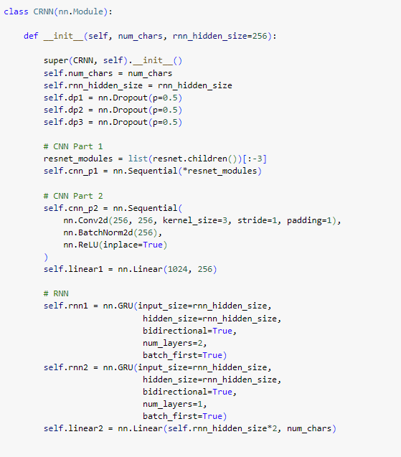
GOKARAJU RANGARAJU INSTITUTE OF ENGINEERING AND TECHNOLOGY
Department of Computer Science and Engineering
MAJOR Project Phase-II Review-2
Experimentation
Fig 5: CRNN
Fig 6: CRNN

Slide 8
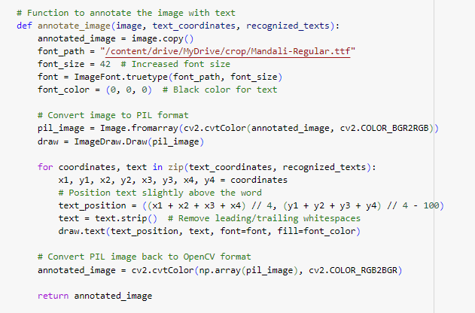
GOKARAJU RANGARAJU INSTITUTE OF ENGINEERING AND TECHNOLOGY
Department of Computer Science and Engineering
MAJOR Project Phase-II Review-2
Experimentation
Fig 7: Annotation

Slide 9
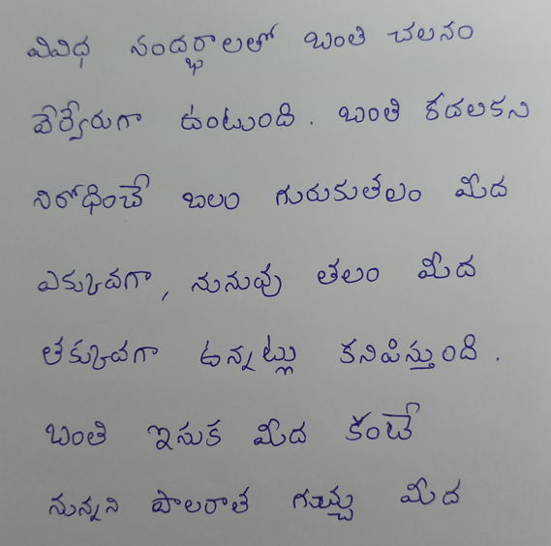
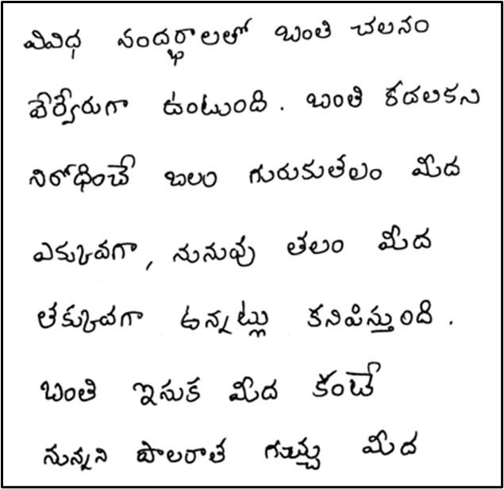
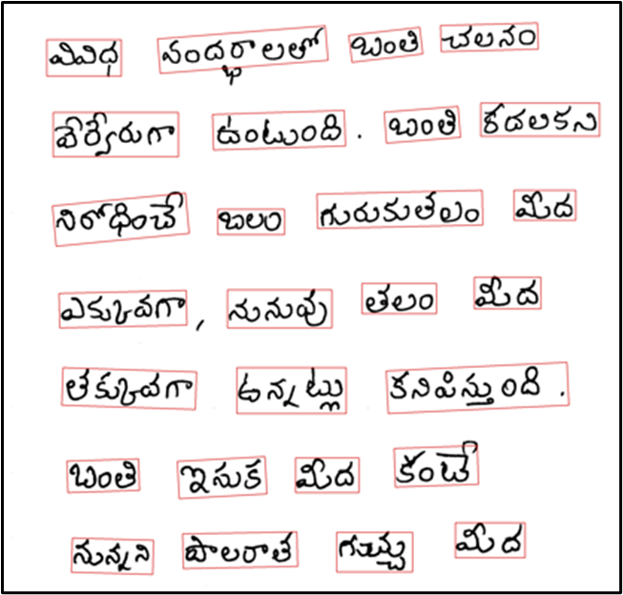
Fig 8: Original Image Fig 9: Image After De-GAN Fig 10: Image After CRAFT
GOKARAJU RANGARAJU INSTITUTE OF ENGINEERING AND TECHNOLOGY
Department of Computer Science and Engineering
MAJOR Project Phase-II Review-2
Results :

Slide 10
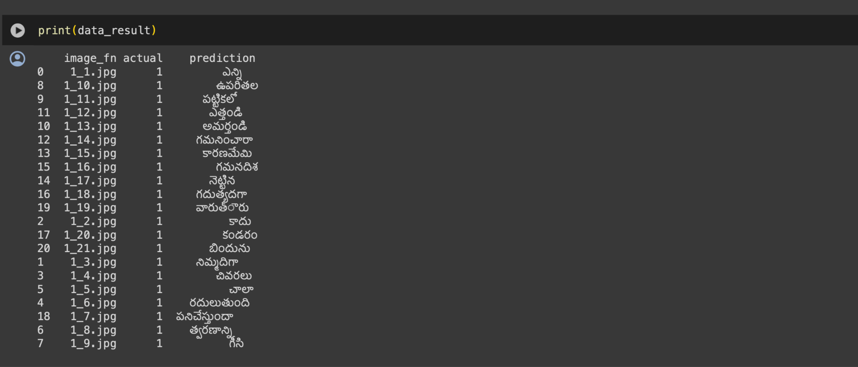
Fig 11: Prediction Result
GOKARAJU RANGARAJU INSTITUTE OF ENGINEERING AND TECHNOLOGY
Department of Computer Science and Engineering
MAJOR Project Phase-II Review-2
Results:

Slide 11
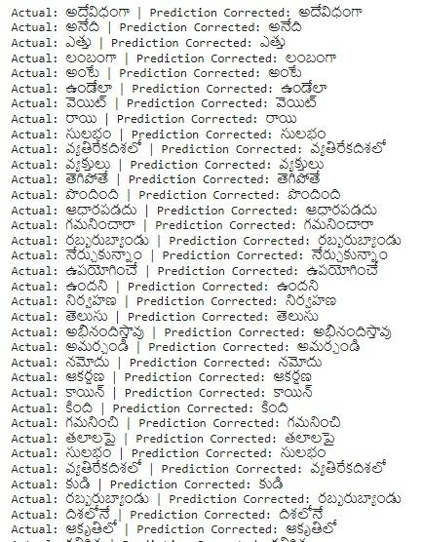
Fig 12: Prediction Result
GOKARAJU RANGARAJU INSTITUTE OF ENGINEERING AND TECHNOLOGY
Department of Computer Science and Engineering
MAJOR Project Phase-II Review-2
Results:

Slide 12
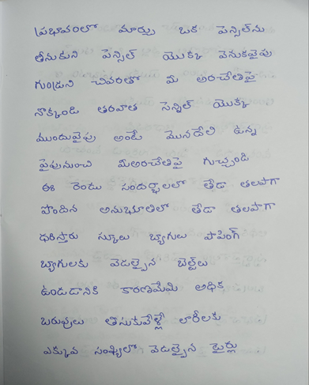
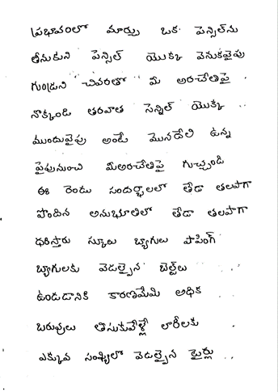
GOKARAJU RANGARAJU INSTITUTE OF ENGINEERING AND TECHNOLOGY
Department of Computer Science and Engineering
MAJOR Project Phase-II Review-2
Test Cases
ID | Test Data | Output
1

Slide 13
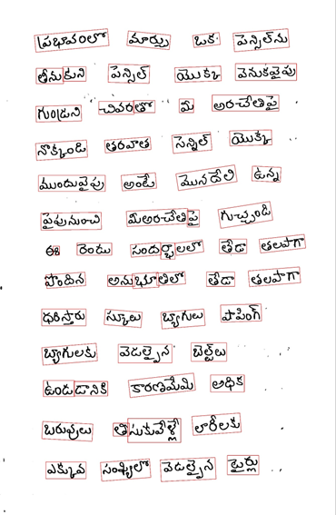
GOKARAJU RANGARAJU INSTITUTE OF ENGINEERING AND TECHNOLOGY
Department of Computer Science and Engineering
MAJOR Project Phase-II Review-2
Test Cases
ID | Test Data | Output
2

Slide 14
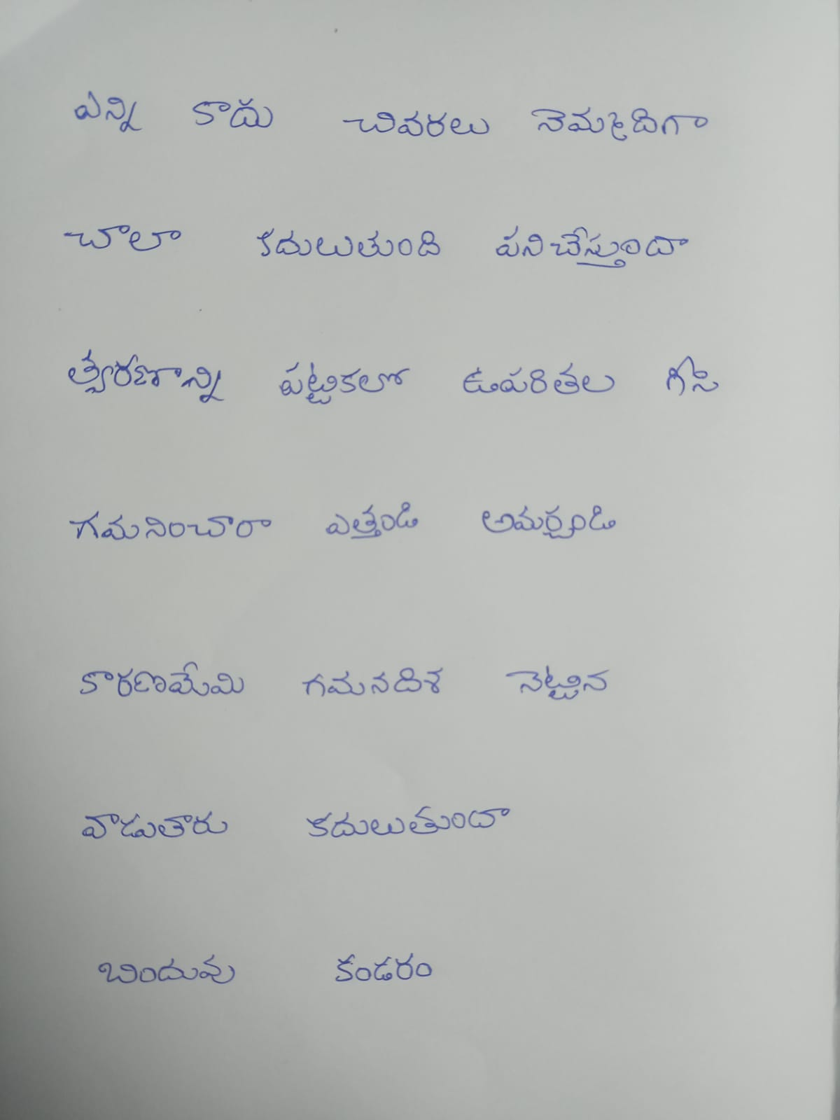
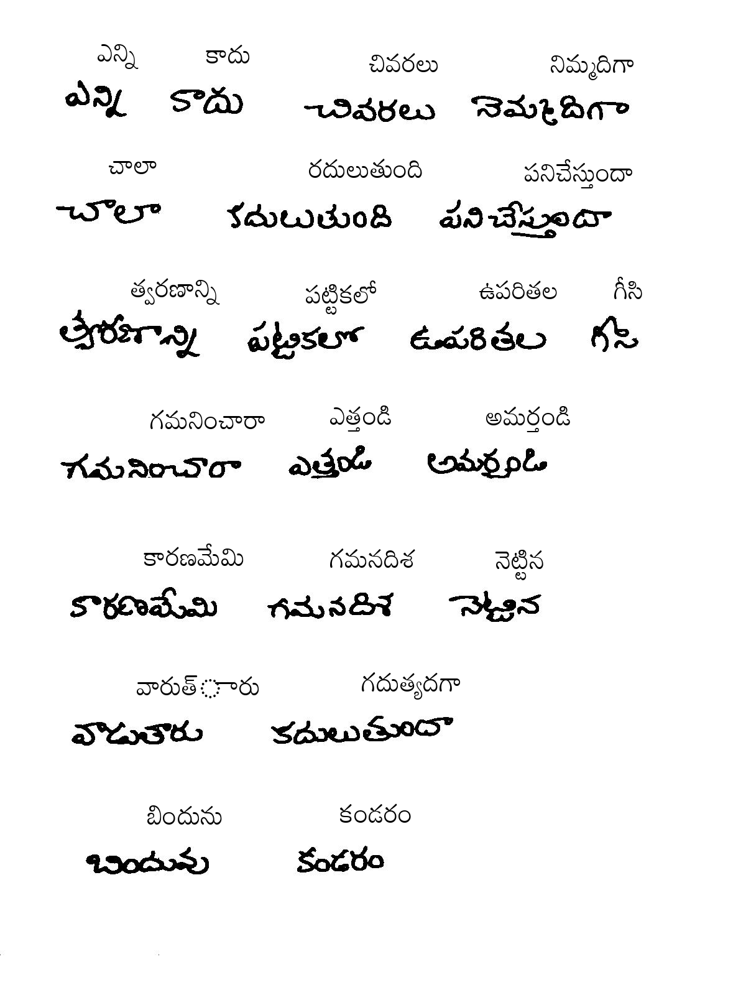
GOKARAJU RANGARAJU INSTITUTE OF ENGINEERING AND TECHNOLOGY
Department of Computer Science and Engineering
MAJOR Project Phase-II Review-2
Test Cases
ID | Test Data | Output
3

Slide 15
GOKARAJU RANGARAJU INSTITUTE OF ENGINEERING AND TECHNOLOGY
Department of Computer Science and Engineering
MAJOR Project Phase-II Review-2
Proposed Main Paper:
Annotation is the practice of supplementing text with extra details or labels to offer context, enhance comprehension, or facilitate the refinement of Natural Language Processing (NLP) models. In our forthcoming paper, we delve into the meticulous steps we have undertaken to achieve annotation specifically tailored for the Telugu language. Our exploration extends to the algorithms we have employed, namely CRAFT, DEGAN, and CRNN. Through meticulous examination and comparison with alternative models, we aim to elucidate the efficacy and nuances of these approaches in the context of annotating Telugu language text.

Slide 16
GOKARAJU RANGARAJU INSTITUTE OF ENGINEERING AND TECHNOLOGY
Department of Computer Science and Engineering
MAJOR Project Phase-II Review-2
Conclusion :
In conclusion, an Automated Annotation System designed for document text images brings transformative benefits to various industries. By leveraging advanced image processing techniques, such as Optical Character Recognition (OCR) and deep learning algorithms, this system significantly enhances document analysis, data extraction, and information retrieval processes. It optimizes efficiency, accuracy, and productivity by automating the time-consuming task of manual annotation. This system finds applications in areas ranging from digitizing historical archives and cataloging large document databases to aiding in content indexing and semantic understanding. As technology continues to advance, the development and adoption of Automated Annotation Systems for Document Text Images hold the promise of revolutionizing the way we interact with and extract knowledge from textual documents.
We have successfully executed De-GAN for pre-processing, CRAFT for text detection and CRNN for recognizing document text images of Telugu language. We annotated the images using dimensions given by CRAFT.

Slide 17
GOKARAJU RANGARAJU INSTITUTE OF ENGINEERING AND TECHNOLOGY
Department of Computer Science and Engineering
MAJOR Project Phase-II Review-2
References:
1. Souibgui, M. A. and Kessentini, Y., “DE-GAN: A Conditional Generative Adversarial Network for Document Enhancement”, <i>arXiv e-prints</i>, 2020. doi:10.48550/arXiv.2010.08764.9
2. Y. Baek, B. Lee, D. Han, S. Yun and H. Lee, "Character Region Awareness for Text Detection," 2019 IEEE/CVF Conference on Computer Vision and Pattern Recognition (CVPR), Long Beach, CA, USA, 2019, pp. 9357-9366, doi: 10.1109/CVPR.2019.00959.
3. Base paper : Mondal, Ajoy & Tulsyan, Krishna & Jawahar, C.. (2022). Automatic Annotation of Handwritten Documents in Word Level. 10.1145/3571600.3571645.

Slide 18
GOKARAJU RANGARAJU INSTITUTE OF ENGINEERING AND TECHNOLOGY
Department of Computer Science and Engineering
MAJOR Project Phase-II Review-2
References:
4. Marti, U-V., and Horst Bunke. "The IAM-database: an English sentence database for offline handwriting recognition." International Journal on Document Analysis and Recognition 5 (2002): 39-46.
5. Pippi, Vittorio, Silvia Cascianelli, and Rita Cucchiara. "Handwritten Text Generation from Visual Archetypes." Proceedings of the IEEE/CVF Conference on Computer Vision and Pattern Recognition. 2023.
6. Mustafa, W. A., et al."A comprehensive review on document image (DIBCO) database."IOP Conference Series: Materials Science and Engineering . V ol. 557. No. 1. IOP Publishing, 2019.
7. Zhou, X., “EAST: An Efficient and Accurate Scene Text Detector” , <i>arXiv e-prints</i>, 2017.doi:10.48550/arXiv.1704.03155 .

Slide 19
GOKARAJU RANGARAJU INSTITUTE OF ENGINEERING AND TECHNOLOGY
Department of Computer Science and Engineering
MAJOR Project Phase-II Review-2
References:
8. Liu, Yuliang, et al. "Abcnet: Real-time scene text spotting with adaptive bezier-curve network." proceedings of the IEEE/CVF conference on computer vision and pattern recognition. 2020.
9. Z. Zhong, L. Jin and S. Huang, "DeepText: A new approach for text proposal generation and text detection in natural images," 2017 IEEE International Conference on Acoustics, Speech and Signal Processing (ICASSP), New Orleans, LA, USA, 2017, pp. 1208-1212, doi: 10.1109/ICASSP.2017.7952348.
10. Ait Bella, F.Z., El Rhabi, M., Hakim, A. et al. An innovative document image binarization approach driven by the non-local p-Laplacian. EURASIP J. Adv. Signal Process. 2022, 50 (2022).
11. Mustafa, Wan & Kader, Mohamed. (2018). Binarization of Document Images: A Comprehensive Review. Journal of Physics: Conference Series. 1019. 012023. 10.1088/1742-6596/1019/1/012023.

Slide 20
GOKARAJU RANGARAJU INSTITUTE OF ENGINEERING AND TECHNOLOGY
Department of Computer Science and Engineering
MAJOR Project Phase-II Review-2
References:
12. Coquenet, Denis & Chatelain, Clement & Paquet, Thierry. (2020). End-to-end Handwritten Paragraph Text Recognition Using a Vertical Attention Network.
13. Ganji, T., Sekhar Velpuru, M., and Dugyala, R., “Multi Variant Handwritten Telugu Character Recognition Using Transfer Learning”, in <i>Materials Science and Engineering Conference Series</i>, 2021, vol. 1042, no. 1, p. 012026. doi:10.1088/1757-899X/1042/1/012026.
14. Mathew, Minesh, and C. V. Jawahar. "An empirical study of CTC based models for OCR of Indian languages." arXiv preprint arXiv:2205.06740 (2022).
15. Trippe, Theophil, et al. "Let's enhance: A deep learning approach to extreme deblurring of text images." arXiv preprint arXiv:2211.10103 (2022).

Slide 21
THANK YOU & QUERY
GOKARAJU RANGARAJU INSTITUTE OF ENGINEERING AND TECHNOLOGY
Department of Computer Science and Engineering
MAJOR Project Phase-II Review-2

